Slide 1



Slide 2
Contents
1
A look at Monday’s lab
2
Review of recursion
3
Recursive Fibonacci
4
Recursive Tower of Hanoi
@acdit

Slide 3
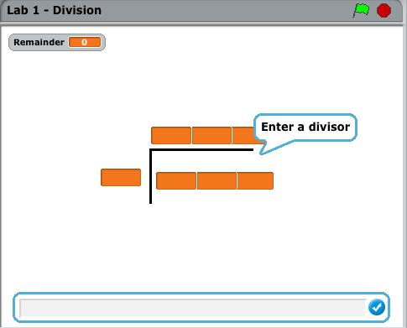
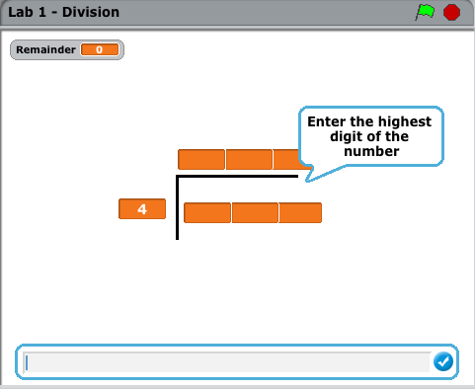
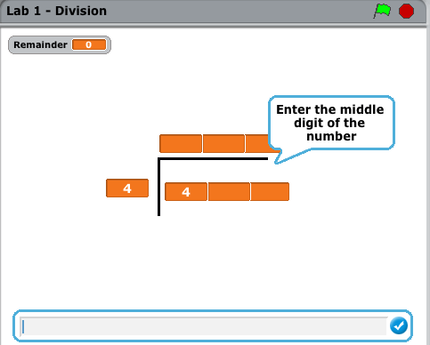
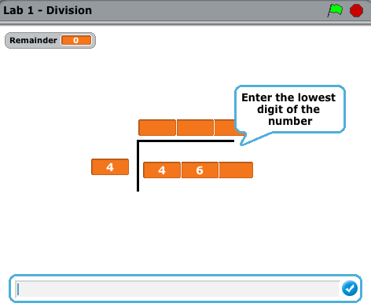
Last Monday’s Lab
@acdit

Slide 4
Enter divisor
Enter highest digit *of number to be divided*
Enter middle digit *of number to be divided*
Enter smallest digit *of number to be divided*
If highest digit < divisor
highest quotient = 0 *the highest number of the answer*
remainder = highest digit * 10
Else
highest quotient = highest digit /divisor
remainder = (highest digit mod divisor)*10
middle digit = (middle digit + remainder)
If middle digit < divisor
middle quotient = 0 *the middle number of the answer*
remainder = middle digit * 10
Else
middle quotient = middle digit /divisor
remainder = (middle digit mod divisor)*10
smallest digit = (smallest digit + remainder)
If smallest digit < divisor
smallest quotient = 0 *the smallest number of the answer*
remainder = smallest digit
Else
smallest quotient = smallest digit /divisor
remainder = smallest digit mod divisor
@acdit

Slide 5
Last Monday’s Lab
Let’s test with the 466/4:
  Divisor =
  Highest digit =
  Middle digit =
  Lowest digit =
What is:
  Highest quotient =
  Middle quotient =
  Lowest quotient =
@acdit

Slide 6
Last Monday’s Lab
Any problems with this algorithm?
Can it be made more efficient?
How is Scratch as a programming language?
@acdit

Slide 7
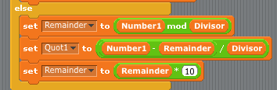
Last Monday’s Lab
How did you get rid of the decimal problem?
Remainder = number1 mod Divisor
Quot1 = (Number1-Remainder)/Divisor
Remainder = Remainder * 10
@acdit

Slide 8
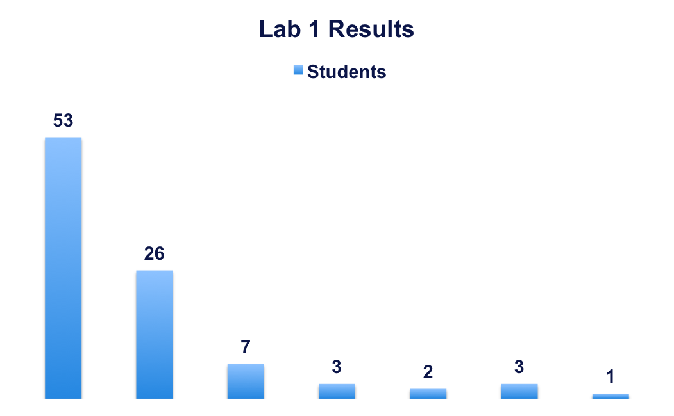
Lab 1 Results
One extra student – re-graded to 0.
100%
90%
80%
70%
60%
40%
30%
@acdit

Slide 9
Reminder: What is Recursion?
When one function calls ITSELF directly or indirectly.
@acdit

Slide 10
When should I use Recursion?
If the algorithm has a base case
If a problem is iterative
If the problem gets progressively smaller
@acdit

Slide 11
Reminder: Recursive Factorial
What is the algorithm?
@acdit

Slide 12
Reminder: Recursive Factorial
Remember this …. 4!
  Factorial (n)
  if n=1 or n=0
  return 1
  else
  return n*Factorial(n-1)
Call Stack
BASE CASE REACHED - 1
2*Factorial(1)
3*Factorial(2)
4*Factorial(3)
Factorial(4)
@acdit

Slide 13
Recursive Factorial
Remember this from last week …. 4!
  Factorial (n)
  if n=1 or n=0
  return 1
  else
  return n*Factorial(n-1)
POP
4
*
3
*
2
*
1
=
24
@acdit

Slide 14
Recursive Power
Write the recursive algorithm for Power.
Illustrate the call stack for 2⁵
@acdit

Slide 15
Recursive Euclid’s Algorithm
gcd(a, b)
if (b = 0) then
return a
else
return gcd(b, a mod b)
Illustrate this recursive algorithm using a call stack – gcd (72, 30)
@acdit

Slide 16
Write an iterative GCD algorithm
@acdit

Slide 17
An iterative solution ….
gcd(a, b)
if b=0 then
return a
else
while b!=0
rem = a mod b
If rem=0
return b
else
a=b
b=rem
Does this work?
Test it with (72, 30)
@acdit

Slide 18
Fibonacci
The Fibonacci Sequence is the series of numbers:
  0, 1, 1, 2, 3, 5, 8, 13, 21, 34, ...
The next number is found by adding up the two numbers before it.
@acdit

Slide 19
Fibonacci
Can you calculate the following?
  Term 7
  Term 9
@acdit

Slide 20
Fibonacci
What is the base case?
What is the recursive call?
@acdit

Slide 21
Recursive Fibonacci
Let’s try this with n=5
fibonacci(n)
if (n=0 or n=1)
return n
else
return fibonacci(n-1) + fibonacci(n-2)
@acdit

Slide 22
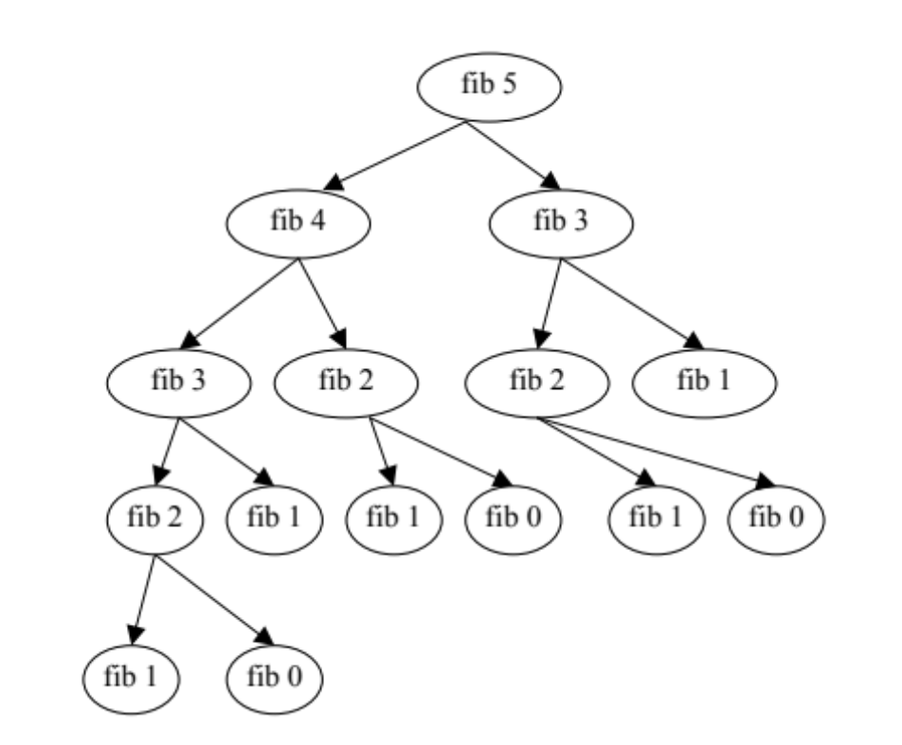
Fibonacci
Let’s try this with n=5
@acdit

Slide 23
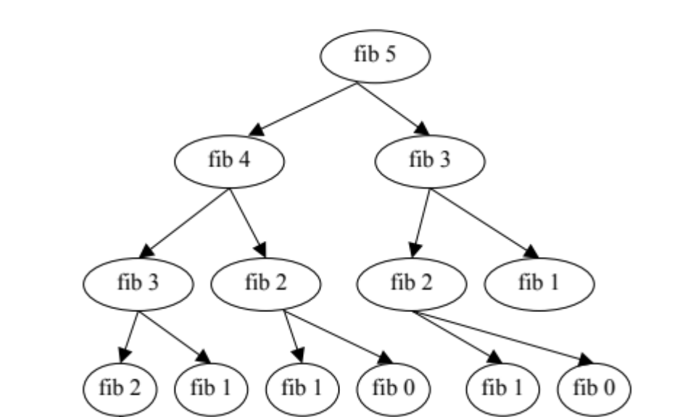
Fibonacci
Let’s try this with n=5
1+
POP
@acdit

Slide 24
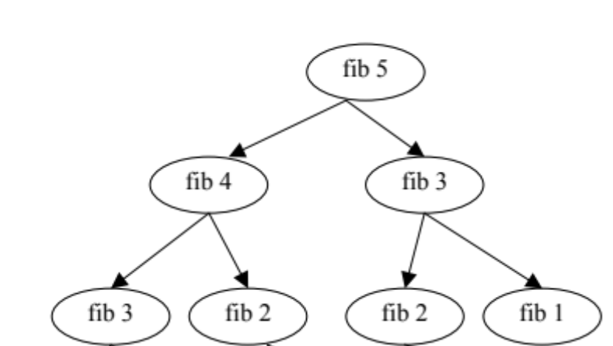
Fibonacci
Let’s try this with n=5
1 + 1
1 + 0
1 + 0
1
POP
@acdit

Slide 25
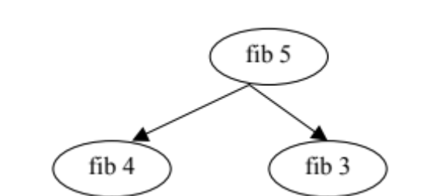
Fibonacci
Let’s try this with n=5
2 + 1
1 + 1
POP
@acdit

Slide 26
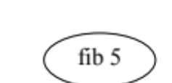
Fibonacci
Let’s try this with n=5
3 + 2
POP
@acdit

Slide 27
A more complicated use of recursion – The Towers of Hanoi
@acdit

Slide 28
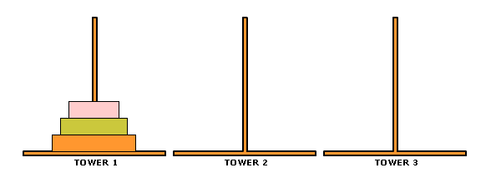
The Towers of Hanoi
Rules
  Move all disks to Tower 3
  Only one disk can be moved at a time
  A disk can never be put on a smaller disk
@acdit

Slide 29
The Towers of Hanoi
What is the problem?
  Move the largest disk, disk2, to Tower 3
  Move the middle disk, disk1, to Tower 3
  Move smallest disk, disk0, to Tower 3
@acdit

Slide 30
The Towers of Hanoi
Why is this suitable for recursion?
  Because there is a base case
  The problem is iteratively getting smaller
@acdit

Slide 31
The Towers of Hanoi
0
1
2
Source
Spare
Dest
Disks = 2 (0,1,2)
@acdit

Slide 32
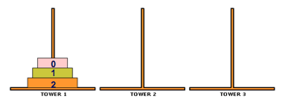
The Towers of Hanoi: A recursive algorithm
moveTower (disks, source, dest, spare)
If disk = 0 **if smallest disk
Move disk from source to dest **moves smallest disk
else
moveTower (disk-1, source, spare, dest)
move disk from source to dest **moves other 2 disks
moveTower (disk-1, spare, dest, source)
@acdit

Slide 33
Thank You !

